Slide 1
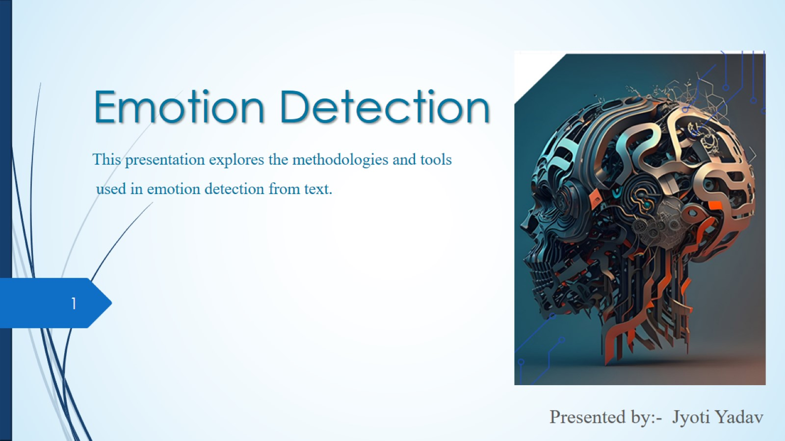
Emotion Detection This presentation explores the methodologies and tools used in emotion detection from text.

Slide 2
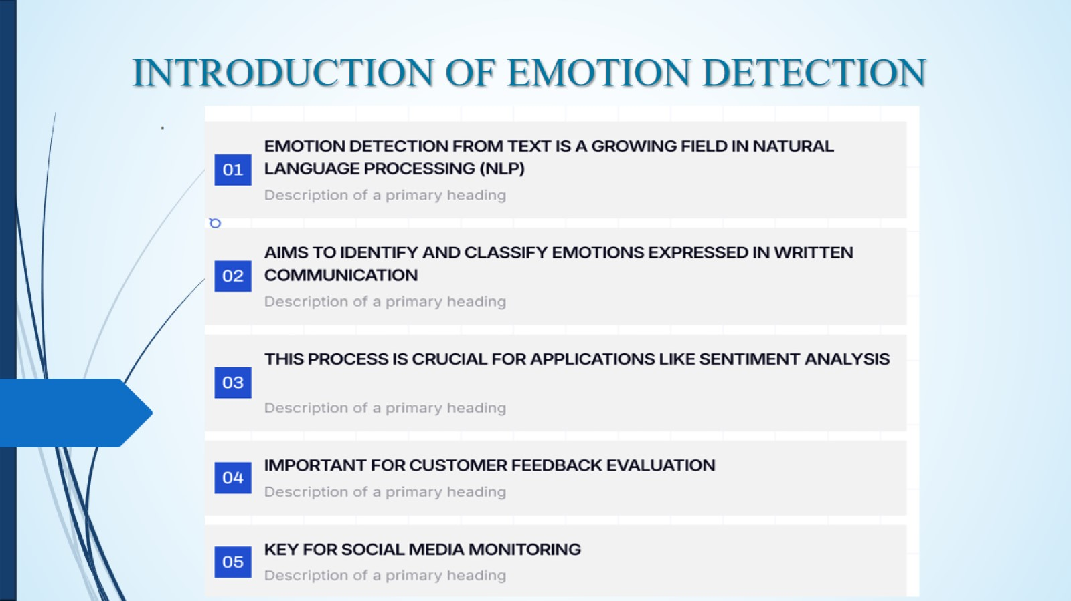
INTRODUCTION OF EMOTION DETECTION

Slide 3
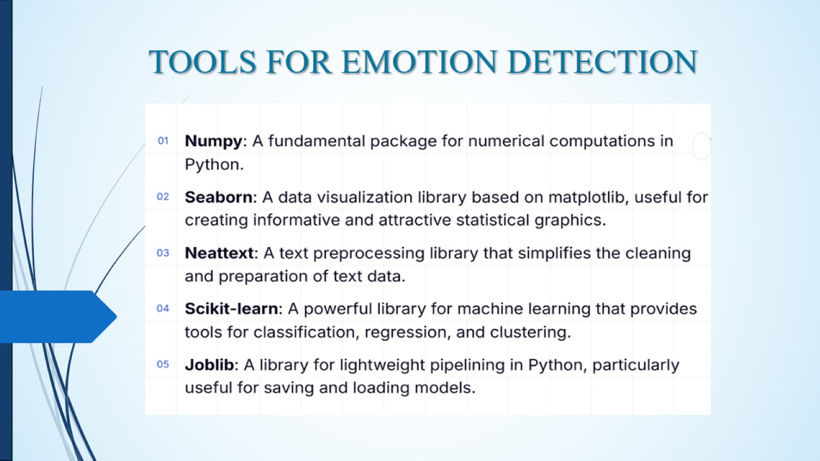
TOOLS FOR EMOTION DETECTION

Slide 4
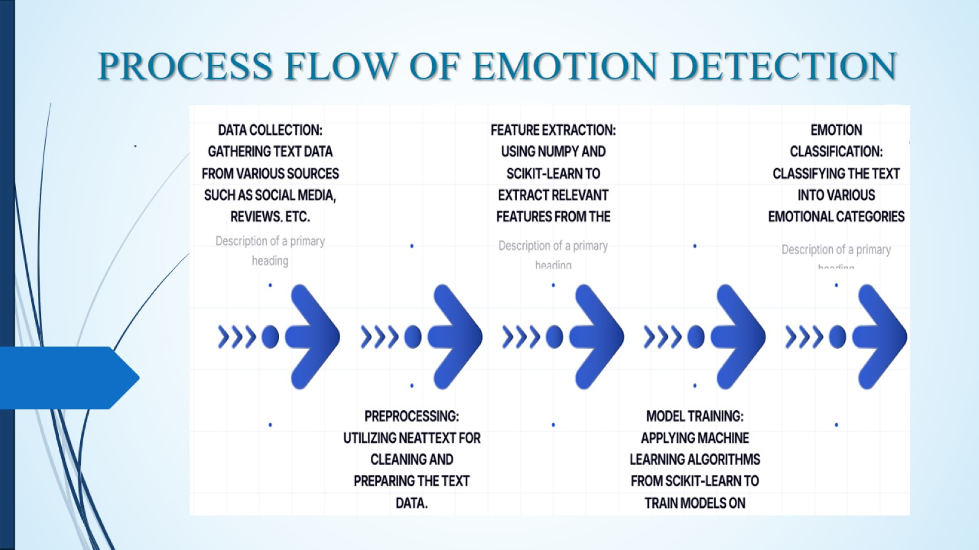
PROCESS FLOW OF EMOTION DETECTION

Slide 5

Thank you

